Slide 1
Theory of Estimation and Hypothesis Testing
Introduction to Statistics

Slide 2
Agenda
Theory of Estimation
Point estimation
Sampling error
Interval estimation
Hypothesis Testing
Terminologies
Decision making method
Test based on Z statistic
Error in hypothesis testing

Slide 3

Statistics
Statistics
Descriptive Statistics
Inferential Statistics
It is used to only describe the sample or summarize information about the sample
It is used to make inferences and generalizations about the broader population from the sample

Slide 4
Inferential Statistics

Slide 5
Inferential statistics
Inferential Statistics
Theory of Estimation
Testing of Hypothesis
Estimating the population parameter from the sample
Test the statistical significance of a claim
Point Estimation
Interval Estimation

Slide 6
Point Estimation

Slide 7
Estimate
Question:
What would be the average income of a 27-year-old in London? How would you calculate it?

Slide 8
Estimate
Solution:
The trivial way is to collect the income data of every 27-year-old, further compute its mean.
This mean would be the population mean.

Slide 9
Point estimation
Is this scenario feasible? Is it possible to collect data of every 27-year-old person?
To do so, draw a sample of size n and compute the mean.
This sample mean is the point estimate of the population mean

Slide 10
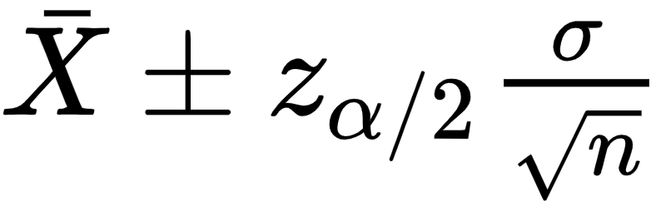
Point estimation
The sample estimate is considered to be the point estimate of the population parameter
If population parameters are not known they are estimated from the sample
The point estimate of
population mean ( ) is sample mean (µ)
population variance (σ) is sample variance s²
Population proportion (P) is sample proportion (p)

Slide 11
Sampling error
Sampling error is the absolute difference between the population parameter and its sample statistic (point estimate)
Since the entire population is not considered as the sample, the values of mean, median, quantiles, and so on calculated on sample differ from the actual population values.
In order to reduce sampling error increase the sample size

Slide 12
Sample size
Question:
The average temperature on a summer morning in Alaska is 55ºF. The research student of climate studies records the temperature for 15 summer mornings in ºF.
Data = [49.8, 52.3, 51, 56.9, 54.8, 63, 58.2, 54.1, 50.4, 49.2, 47, 51.3, 43.5, 56, 55]
Find the sampling error for the average temperature.

Slide 13

Point Estimate
Question:
A financial firm has created 50 portfolios. From them a sample of 13 portfolios was selected, out of which 8 were found to be underperforming. Estimate the number of underforming portfolios?

Slide 14
Point Estimate
Solution:
A financial firm has created 50 portfolios. Thus N = 50
From them a sample of 13 portfolios was selected. Thus n = 13
The desired category is of underperforming portfolios. 8 of 13 were found to be underperforming. Thus x = 8
To find: Estimate the number of underperforming portfolios

Slide 15
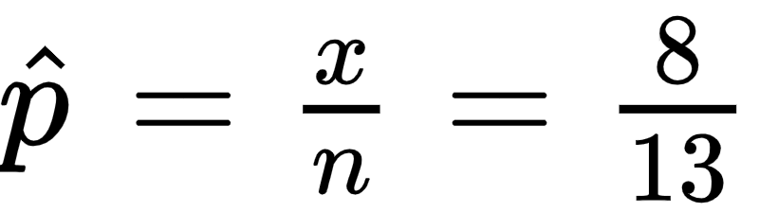
Point Estimate
Solution:
The estimate of proportion of underperforming portfolios is given by
To estimate the number of underperforming portfolios multiply by the estimate by N.

Slide 16
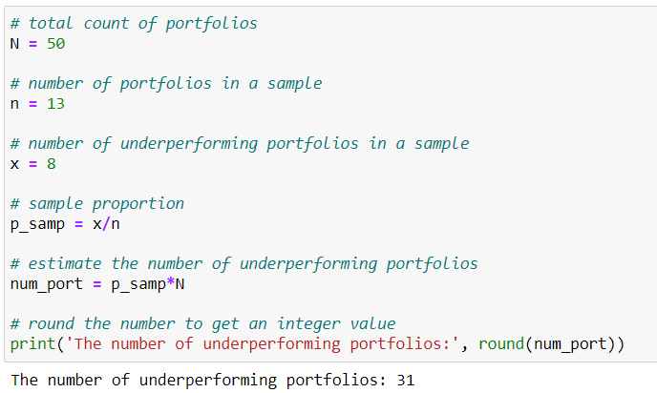
Point Estimate
Python solution:

Slide 17
De-Merit of Point Estimate
Add sampling error

Slide 18
Interval Estimation

Slide 19
Need of interval estimation
The point estimate is taken from a particular sample
For a different sample, we get a different estimate (sampling variability)
This problem is resolved if we obtained the interval estimate
Sample means of different samples
m₂ m₃ m₁ m₄

Slide 20
Interval Estimation
Interval estimate is a range or an interval within which the parameter lies for a stated confidence level
Based on the central limit theorem
It is known as the confidence interval

Slide 21
Confidence level
Confidence level (1-α) is the percentage of all possible point estimates that can be expected to include the actual population parameter
α is known as the level of significance
The higher confidence level illustrates the wider confidence interval
A 95% confidence level implies that 95% of the confidence intervals would include the actual population parameter

Slide 22
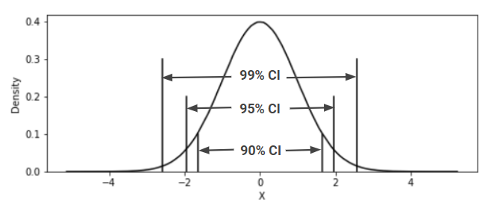
Confidence level
Example:
The average income estimate for a 27-year-old in London is £45,000. After taking repeated samples, the 99% confidence intervals of the average income include the actual population parameter for 99% of the times.

Slide 23
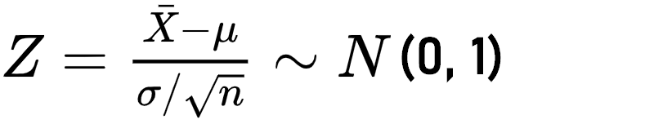
Recall - CLT
For random samples of large size n taken from a single population with mean µ and standard deviation σ, the sampling distribution of mean follows a normal distribution with mean µ and standard deviation σ/√n

Slide 24
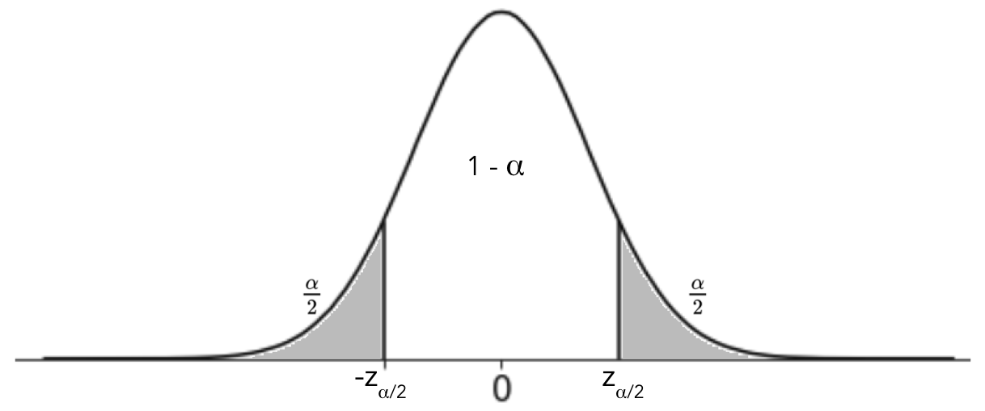
Interval estimate
From the CLT, P(-z_{α/2} ≤ Z ≤ z_{α/2}) = 1 - α
Where α is is the level of significance

Slide 25
Interval estimate
From the CLT, P(-z_{α/2} ≤ Z ≤ z_{α/2}) = 1 - α
Value of α | Z_{α/2} | Value of Z_{α/2}
0.10 | z_{0.05} | 1.645
0.05 | z_{0.025} | 1.96
0.01 | z_{0.005} | 2.575
Note: To obtain these values in python use scipy.stats.norm.isf()

Slide 26
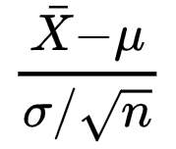

Interval estimate
From the CLT, P(-z_{α/2} ≤ Z ≤ z_{α/2}) = 1 - α and value of Z is
Thus, P(-z_{α/2} ≤ ≤ z_{α/2}) = 1 - α
Rearranging the terms, P( ) = 1 - α
This defines a 100(1 - α)% confidence interval as

Slide 27
Interval estimate
The 100(1 - α)% confidence interval is
Point Estimate
Margin of error

Slide 28
Margin of error
Question:
100 bags of coal were tested and had an average of 35% of ash with a standard deviation of 15%. Calculate the margin of error for a 90% confidence level.

Slide 29
Margin of error
Solution:
100 bags of coal were tested and had an average of 35% of ash with a standard deviation of 15%. Here n =100 σ = 0.15
To find: The margin of error for a 90% confidence level.
Here α = 0.10. Thus z_{α/2} = 1.64

Slide 30
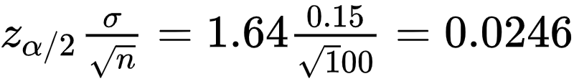
Margin of error
Solution:
The margin of error for a 90% confidence level is
A 90% CI with 2.46% margin of error implies that the sample mean will be within 2.46% points of the real population value 90% of the time

Slide 31
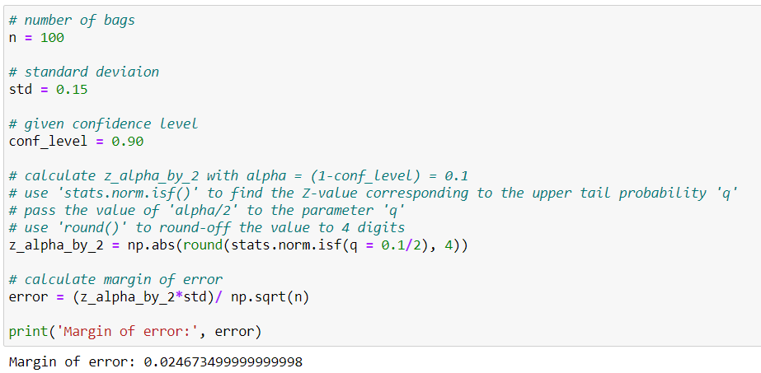
Margin of error
Python solution:

Slide 32
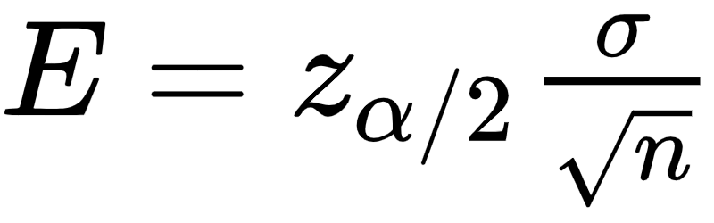
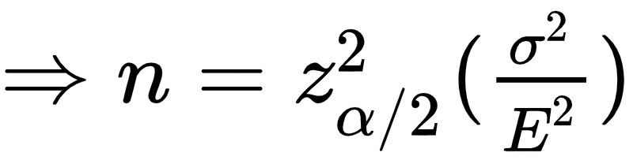
As sample size increases the margin of error decreases
If margin of error is fixed then the sample size can be obtained

Slide 33
Sample size
Question:
For the previous question, for a margin of error 2.46. Verify whether you get sample size of 100.
Previous Question: 100 bags of coal were tested and had an average of 35% of ash with a standard deviation of 15%. Calculate the margin of error for a 90% confidence level.

Slide 34
Interval estimate
Question:
From a sample of 250 observations it is found that average income of a 27-year-old Londoner is £45,000 with a sample standard deviation of £4000. Obtain the 95% confidence interval to estimate the average income.

Slide 35
Interval estimate
Solution:
A sample of 250 observations of a 27-year-old Londoner has an average income of £45,000 with a sample standard deviation of £4000
Thus, = 45,000, σ = 4000 and n = 250
To find: The 95% confidence interval.
Here α = 0.05. So z_{0.025} = 1.96

Slide 36
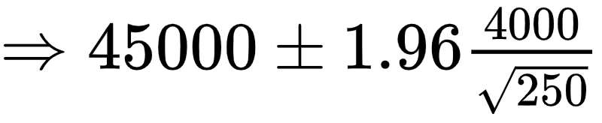

Interval estimate
Solution:
The 95% confidence interval is

Slide 37
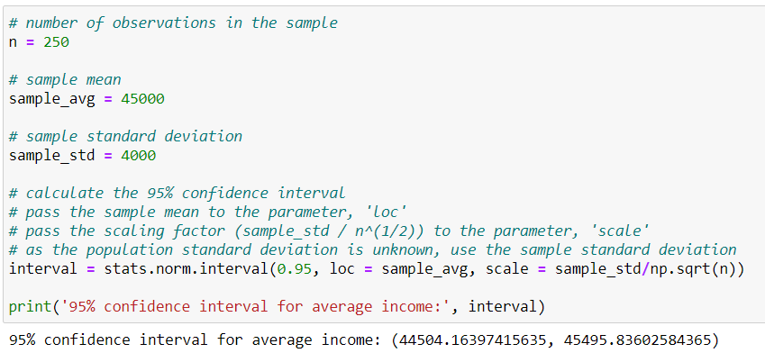
Interval estimate
Python solution:

Slide 38
It cannot be said that P(44504.155≤ µ ≤ 45495.845) = 0.95
The population parameter µ is a constant
It can be said that from many samples drawn of size 250, construct a 95% CI for each sample, roughly 95% of the intervals would actually contain the population parameter µ

Slide 39
Confidence Interval
Question:
For the previous question, obtain the 90% and 99% confidence intervals. Further, logically explain which one of them is the widest.

Slide 40
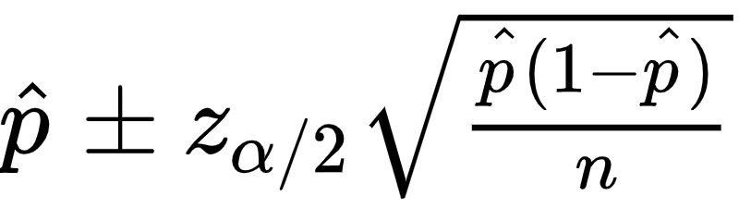
Interval estimate
The 100(1 - α)% confidence interval for proportion is
Point Estimate
Margin of error

Slide 41
Interval estimate
Question:
A financial firm has created 50 portfolios. From them a sample of 13 portfolios was selected, out of which 8 were found to be underperforming. Construct a 99% confidence interval to estimate the population proportion.

Slide 42
Interval estimate
Solution:
From them a sample of 13 portfolios was selected. Thus n = 13
The desired category is of underperforming portfolios. 8 of 13 were found to be underperforming. Thus x = 8
Thus the estimate of sample proportion is x/n = 8/13 =0.615
To find: Construct a 99% confidence interval to estimate the population proportion.

Slide 43
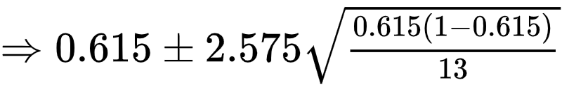
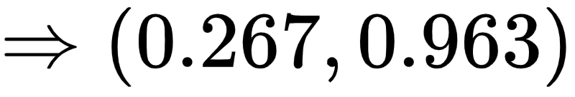
Interval estimate
Solution:
Here α = 0.01. So z_{0.005} = 2.575
The 95% confidence interval is

Slide 44
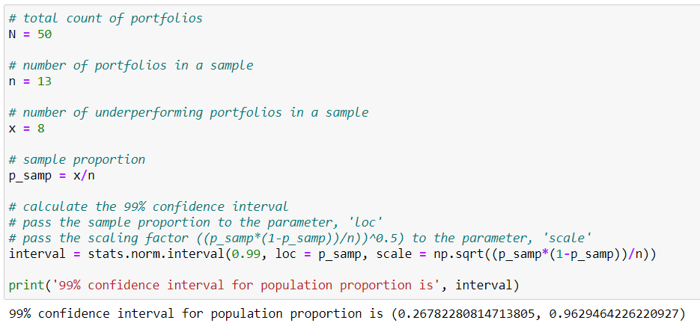
Interval estimate
Python solution:

Slide 45
Summary
Sample estimate of a population parameter is considered as a point estimate
Sample mean, median, standard deviation are the examples of the point estimate
Point estimate varies significantly for different samples
Confidence interval returns the interval estimate for the population parameter
The confidence level describes the uncertainty of the estimate
Confidence interval is calculated using the point estimate and the margin of error
The optimal sample size can be obtained by deciding the required margin of error

Slide 46
Inferential statistics
Inferential Statistics
Theory of Estimation
Testing of Hypothesis
Estimating the population parameter from the sample
Test the statistical significance of a claim
Non-Parametric Tests
Parametric Tests

Slide 47
Testing of Hypothesis

Slide 48
Question:
A manufacturer produces batteries. He claims that the life of his batteries is 25,500 hours. Can we verify his claim?

Slide 49
Solution:
A trivial solution is to obtain the life of all the batteries produced by the manufacturer by using them and thereafter verify this claim
However, by doing so all the manufactured products (batteries) will be exhausted and he will not have any batteries to sell.
To avoid such scenarios, we statistically test the hypothesis

Slide 50
What is a hypothesis?
A hypothesis is a claim about the population parameter
Examples:
The average diameter of bolts manufactured is 200 cm
The new drug is more effective

Slide 51
Hypothesis - example
A pharmaceutical has claimed to have produced a new drug is effective against cancer treatment.
To test the pharmaceuticals claim, first write the test hypotheses - Null Hypothesis and the Alternative Hypothesis
Hypothesis
Null Hypothesis
Alternative Hypothesis

Slide 52
Null and alternative hypothesis
Hypothesis
Null Hypothesis
Alternative Hypothesis
Hypothesis of no change
Denoted by H₀
It directly contradicts the null hypothesis
Also known as research hypothesis
Denoted by H_{a} or H₁

Slide 53
Hypothesis - example
A pharmaceutical has claimed to have produced a new drug which treats the patients against cancer.
Hypothesis
Null Hypothesis
Alternative Hypothesis
H₀: The new drug is not effective
H₁: The new drug is effective

Slide 54
Hypothesis - example
Now consider the effectiveness of the new drug is determined by the number of days a patient requires to recover.
The data for the number of days the patient take to recover are recorded
Let the random variable X be the number of days required to recover
Thus µ is the average number of days required to recover

Slide 55
State the hypothesis
Hypothesis
It is claimed that the new drug reduces the recovery time
µ: the average number of days required to recover
Here, µ₀ is the general recovery time
Null Hypothesis
Alternative Hypothesis
H₀: µ ≥ µ₀
H₁: µ < µ₀

Slide 56
Hypothesis testing
The null and alternative hypothesis are contrasting
Either the null or the alternative hypothesis can be true
The decision of the test procedure is one of the following:
Reject H₀ implies the null hypothesis is false
Fail to reject H₀ implies the null hypothesis is true

Slide 57
“Fail to reject H₀”
The null hypothesis is assumed to be true unless proven to be otherwise
The null hypothesis gets the benefit of doubt
The alternative hypothesis has the burden of proof, i.e. from the data it will have enough evidence to say the null hypothesis is false
Hence, it is preferred to say ‘fail to reject H₀’ instead of accept H₀

Slide 58
Question:
Write the null and alternative hypothesis for the following scenarios:
A bolt manufacturing company claims that the average number of he manufactures in a day is 60
The new virus testing kit takes 20 hours less time than usual testing kit that takes 34 hours for the results
An analyst wants to test whether the Apple Inc. has outperformed in 2019 by 13.5%

Slide 59
A bolt manufacturing company claims that the average number of bolts he manufactures in a day is 60
Solution:
The null and alternative hypothesis for the following scenarios:
Let X: the number of bolts manufactured in a day and
µ: the average number of bolts manufactured in a day
H₀: µ = 60 Against H₁: µ ≠ 60

Slide 60
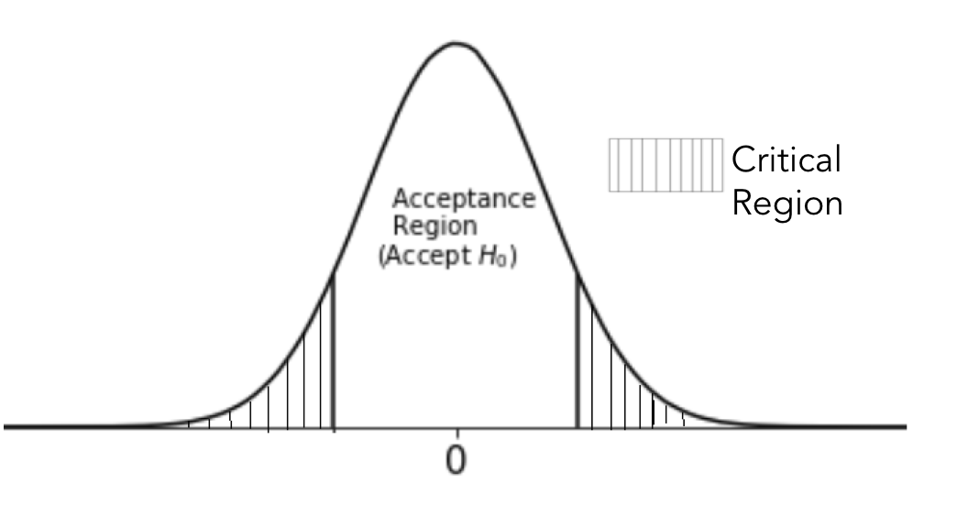
Two tailed test
Two-tailed test is a method in which the critical region of a distribution is split in its two tails. It tests whether a sample is greater than or less than the population parameter.
A critical region is a region in which the null hypothesis is rejected. It is also known as ‘Rejection Region’.
Example
Let X: the number of bolts manufactured in a day and
µ: the average number of bolts manufactured in a day
H₀: µ = 60 Against H₁: µ ≠ 60
α/2
α/2

Slide 61
2. The new virus testing kit takes less time than usual testing kit that takes 34 hours for
the results
Solution:
The null and alternative hypothesis for the following scenarios:
Let X: the time required for the results by a testing kit
µ: the average time required for the results by a testing kit
H₀: µ ≥ 34 Against H₁: µ < 34

Slide 62
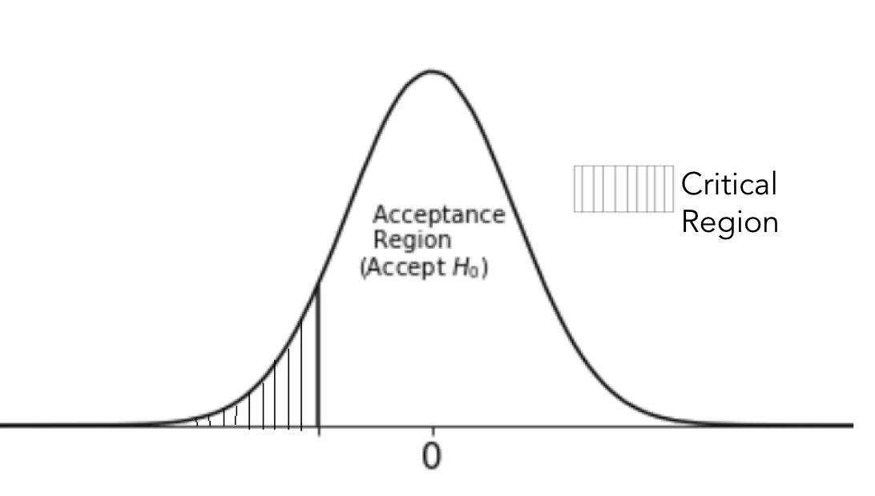
Left tailed test
A left-tailed test is a statistical hypothesis test set up to show that the sample parameter would be lower than the population parameter.
Example
Let X: the time required for the results by a testing kit
µ: the average time required for the results by a testing kit
H₀: µ ≥ 34 Against H₁: µ < 34
α

Slide 63
3. An analyst wants to test whether the Apple Inc. has outperformed in 2019 by 13.5%
Solution:
The null and alternative hypothesis for the following scenarios:
Let X: the performance of Apple Inc. stock
µ: the average performance of Apple Inc. stock
H₀: µ ≤ 13.5 Against H₁: µ > 13.5

Slide 64
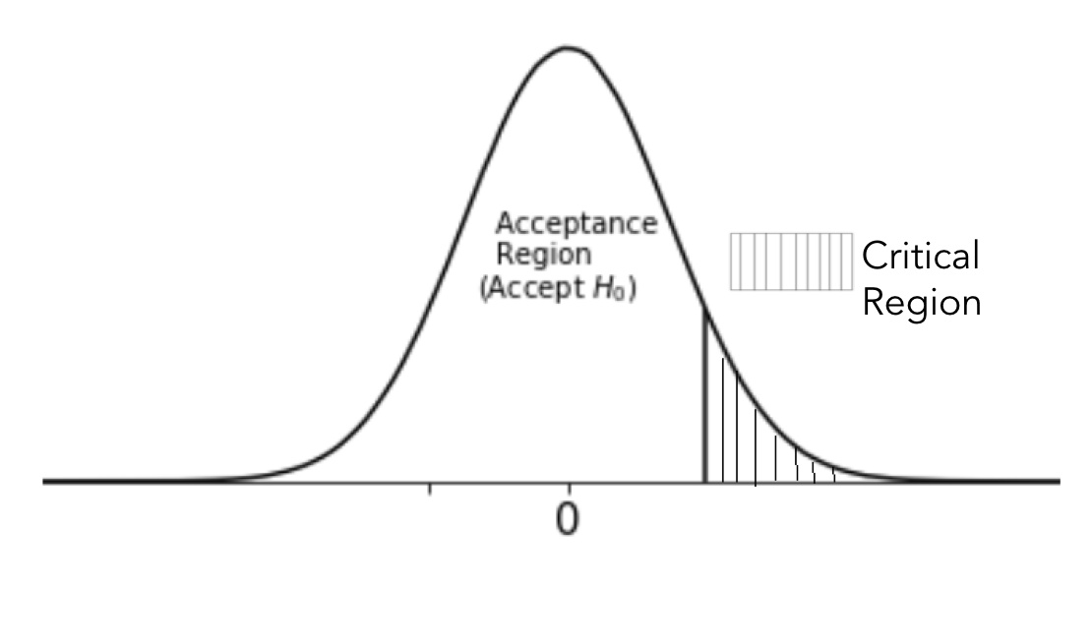
Right tailed test
A right-tailed test is a statistical hypothesis test set up to show that the sample parameter would be higher than the population parameter.
Example
Let X: the performance of Apple Inc. stock
µ: the average performance of Apple Inc. stock
H₀: µ ≤ 13.5 Against H₁: µ > 13.5
α

Slide 65
Write the null and alternative hypothesis and identify the type of the test.
To test the hypothesis that the mean diastolic blood pressure for a group of 85 adults is less than 90mm
The tensile strength of an alloy is more than 500 Pa
The average heart rate of a healthy human is 85 beats per minute
The yield BT cotton is more than 450 kg lint per hectare

Slide 66
Summary
Example | Hypothesis | Test Type
The company manager claims that the average weight of cookies in a gift box is 235 gm | H₀: μ = 235 H₁: μ ≠ 235 | Two Tailed Test
The station officer claims that the bullet train takes less than 2 hours from London to Brussels | H₀: μ ≥ 2 H₁: μ < 2 | Left Tailed Test
To test whether the average number of boat rides are more than 10 per day | H₀: μ ≤ 10 H₁: μ > 10 | Right Tailed Test

Slide 67
Decision Making Methods

Slide 68
Decision making methods
Test statistic, p-value and confidence interval are the three different criterias to test the acceptance/ rejection of null hypothesis
Test statistic is a sample statistic that is used to conduct a hypothesis test
The p-value criteria returns the probability of getting the value greater than or equal to the test statistic
The null hypothesis is accepted if the confidence interval contains the specified population parameter

Slide 69
Test statistic
The decision whether to accept or reject the null hypothesis is based on the test statistic value
Depending upon the problem in hand the test statistic changes
The test statistic is used to quantify the sample data that distinguishes the null and alternative hypothesis
The sampling distribution of a test statistic under the null hypothesis is used to calculate the p-value

Slide 70
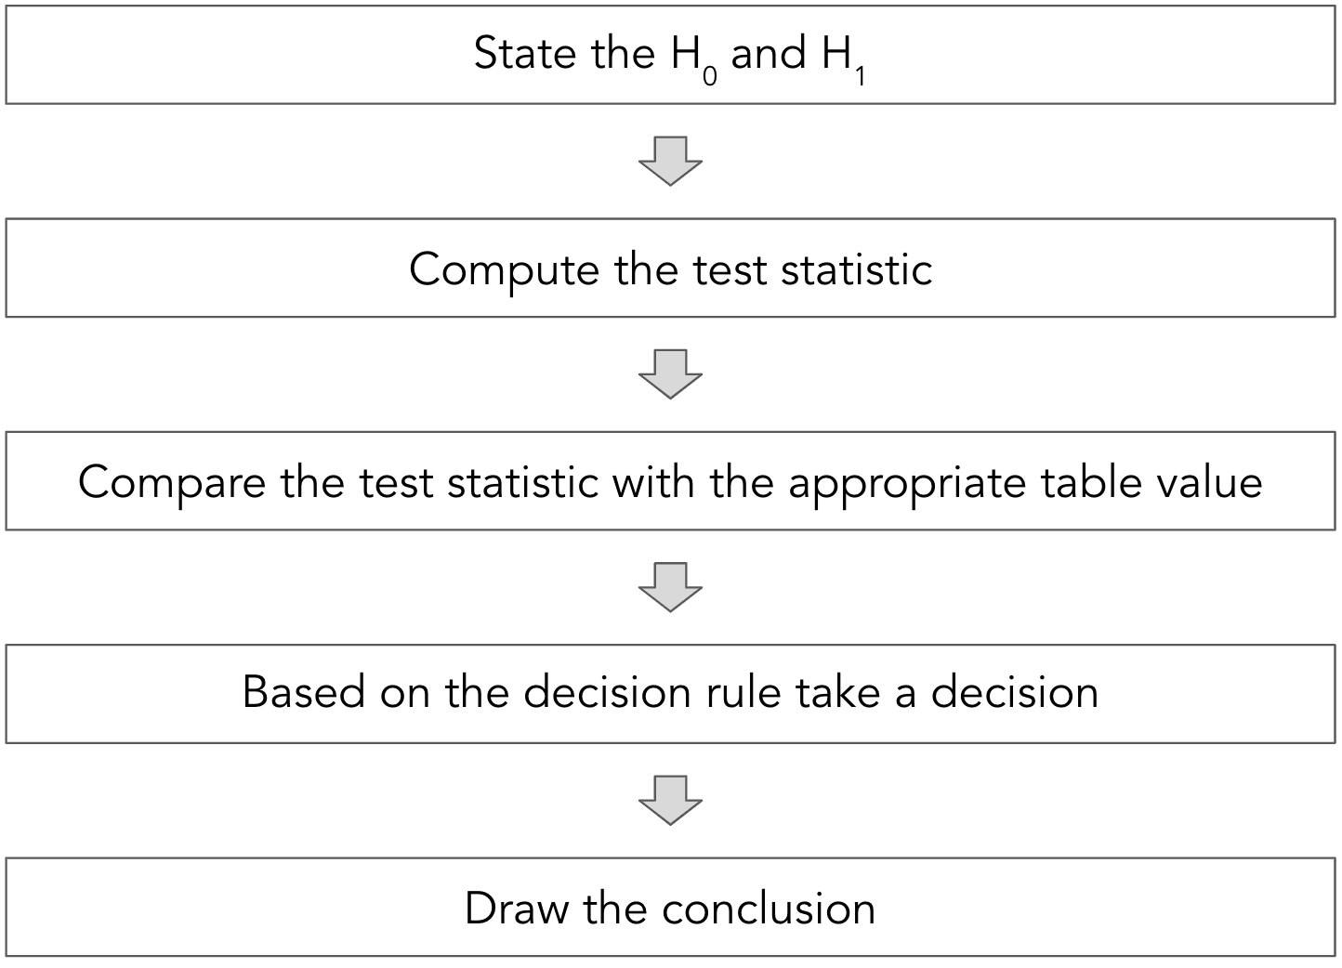
Procedure - using test statistic

Slide 71
The p-value
The p-value is the mostly used criteria while performing the hypothesis test
It is the probability of getting a value greater than or equal to the test statistic
If T is the test statistic and T₀ is calculated value then observed level of significance or p-value is P(T>T₀| H₀ is true)
The test is significant if the p-value is less than or equal to the level of significance (α)

Slide 72
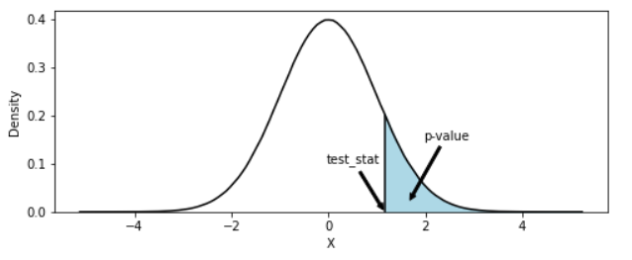
The p-value
The smaller p-value supports the alternative hypothesis, as it exhibits the difference between the observed data and the null hypothesis

Slide 73
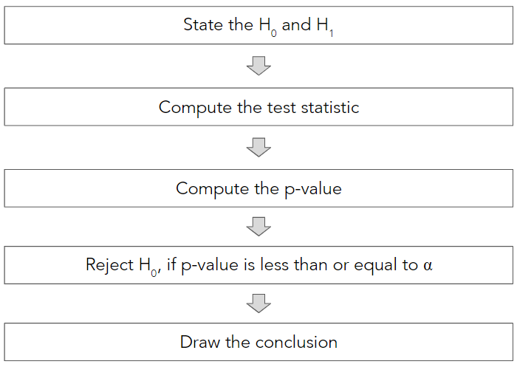
Procedure - using p-value

Slide 74
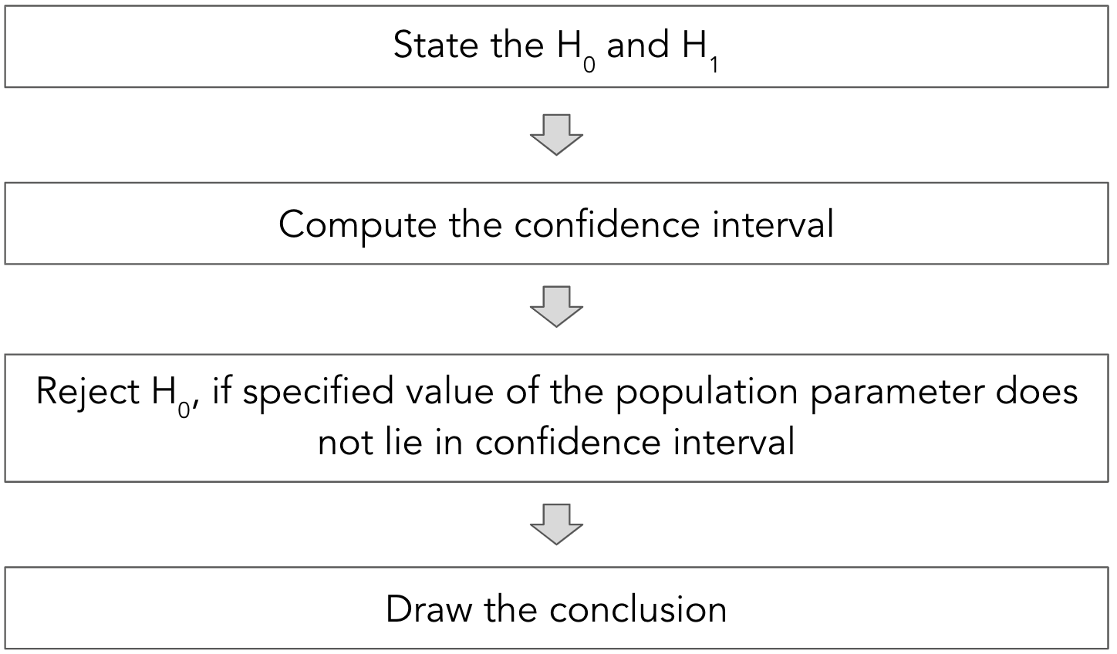
Procedure - using confidence interval

Slide 75
Tests based on Z statistic

Slide 76
Tests based on Z statistic
Assumptions:
The data is continuous in nature
The sample is assumed to be drawn from a population following the normal distribution
The sample is a simple random sample (each observation is equally likely to be drawn)

Slide 77
Test for normality
The hypothesis to test whether the population is normally distributed
H₀: The data is normal against H₁: The data is not normal
Failing to reject H₀, implies that the data is normally distributed
The Shapiro-Wilk test is used
Note: The python code for Shapiro test is scipy.stats.shapiro(Sample)

Slide 78
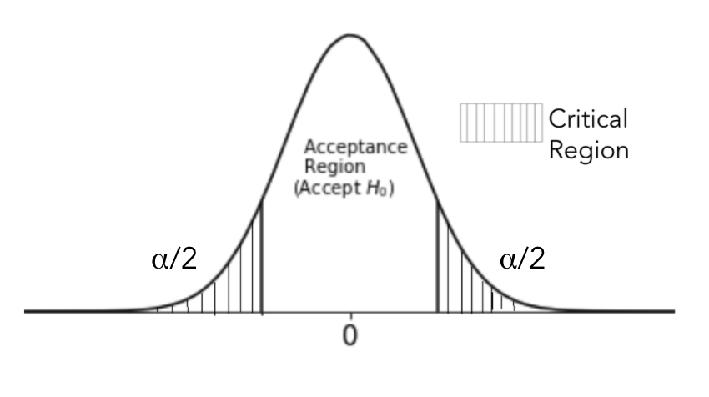
Two tailed test
The hypothesis to test whether the population mean is equal to a specified value
H₀ : µ = µ₀ against H₁ : µ ≠ µ₀
It implies
H₀: The population mean is equal to µ₀
against H₁: The population mean is not equal to µ₀
Failing to reject H₀ implies that population mean is equal to µ₀

Slide 79
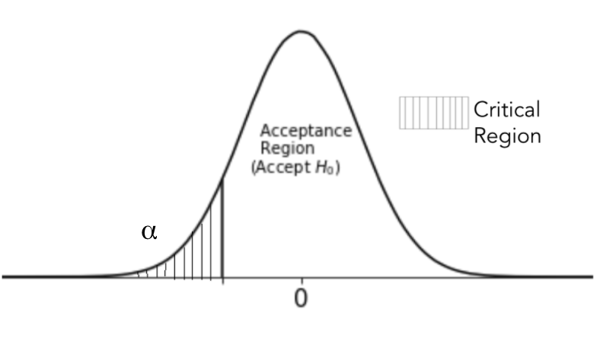
Left tailed test
The hypothesis to test whether the population mean is equal to a specified value
H₀ : µ ≥ µ₀ against H₁ : µ < µ₀
It implies
H₀: The population mean is equal to µ₀
against H₁: The population mean is less than µ₀
Failing to reject H₀ implies that population mean is equal to µ₀

Slide 80
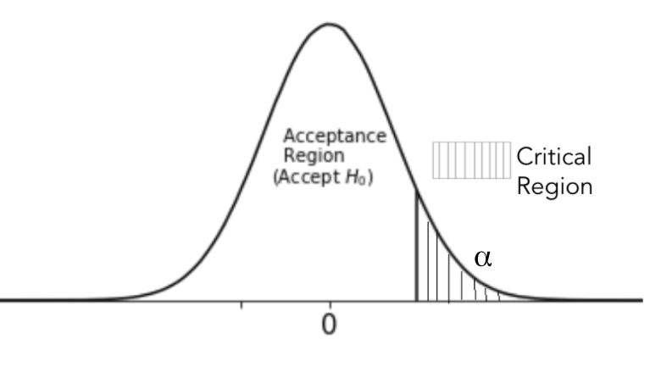
Right tailed test
The hypothesis to test whether the population mean is equal to a specified value
H₀ : µ ≤ µ₀ against H₁ : µ > µ₀
It implies
H₀: The population mean is equal to µ₀
against H₁: The population mean is more than µ₀
Failing to reject H₀ implies that population mean is equal to µ₀

Slide 81
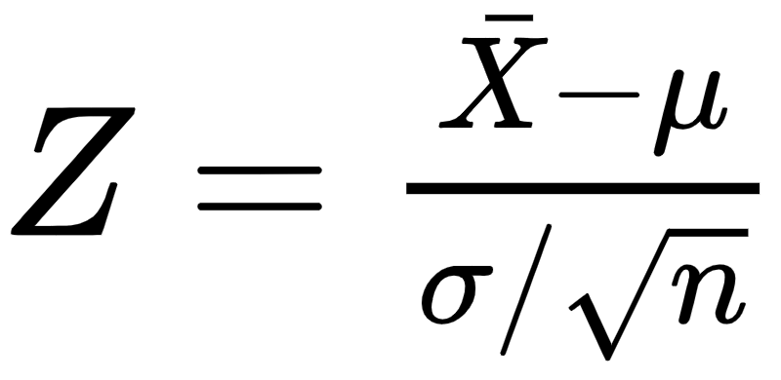
Tests based on Z statistic
The test statistic Z is given by
Sample mean
Specified mean
Population standard deviation
Sample size
Under H₀, the test statistic follows normal distribution

Slide 82
The python code to conduct a Z test for population mean is
statsmodels.stats.weightstats.ztest(sample, value, alternative)

Slide 83
Decision rule
 | H₁ | Based on critical region | Based on p-value | Based on confidence interval
For two tailed test | µ ≠ µ₀ | Reject H₀ if |Z|> Z_{α/2} | Reject H₀ if p-value is less than or equal to the level of significance | Reject H₀ if µ₀ does not lie in the confidence interval
For left tailed test | µ < µ₀ | Reject H₀ if Z < -Z_{α}
For right tailed test | µ > µ₀ | Reject H₀ if Z > Z_{α}

Slide 84
Two tailed test
Question:
A car manufacturing company claims that the mileage of their new car is 25 kmph with a standard deviation of 2.5 kmph. A random sample of 45 cars was drawn and recorded their mileage as per the standard procedure. From the sample, the mean mileage was seen to be 24 kmph. Is this evidence to claim that the mean mileage is different from 25kmph? (assume normality of data)
Test the claim using critical region technique, p-value technique and confidence interval technique. [Use α = 0.01].

Slide 85
Two tailed test
Solution:
A car manufacturing company claims that the mileage of a car is 25 kmph with a standard deviation of 2.5 kmph. Thus µ = 25 kmph and σ = 2.5 kmph
A random sample of 45 cars was drawn and recorded their mileage as per the standard procedure. From the sample, the mean mileage was seen to be 24 kmph. Thus = 24 kmph and n = 45
To find: Evidence to claim that the mean mileage is different from 25kmph

Slide 86
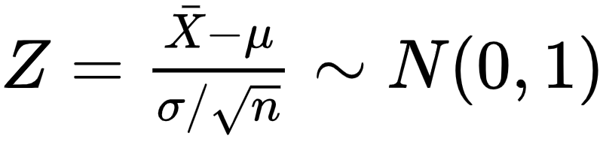
Two tailed test
Solution:
Here X: the mileage of the new car X~N(µ,σ²)
To test, H₀ : µ = 25 against H₁ : µ ≠ 25
Obtain the solution using critical region technique.
The test statistics:

Slide 87
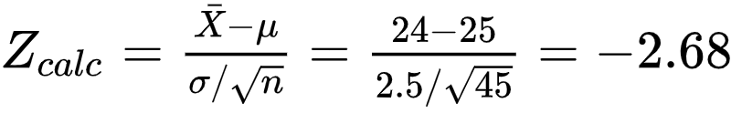
Two tailed test
Solution:
The test statistics:
Here α = 0.01, so z_{0.005} = 2.575
Decision: Reject H₀, if |Z_{calc}| > Z_{α/2}. Here |-2.68| > 2.575.
Thus reject H₀. Thus there is enough evidence to conclude that the mean mileage is different from 25 kmph.
-2.575
2.575

Slide 88

Two tailed test
Solution:
Let us obtain the decision using the p-value method.
The p-value = 2 .P(|Z| > |Z_{calc}|, under H₀) = 2 .P(|Z| > 2.68, µ = 25) … (due to symmetricity) = 0.0074
Since p-value < 0.01, we reject H₀. Thus there is enough evidence to conclude that the mean mileage is different from 25 kmph.
2.68

Slide 89
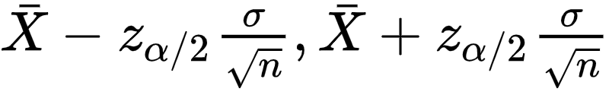
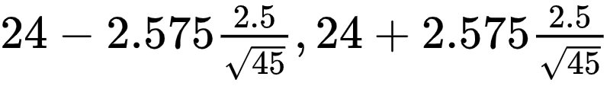
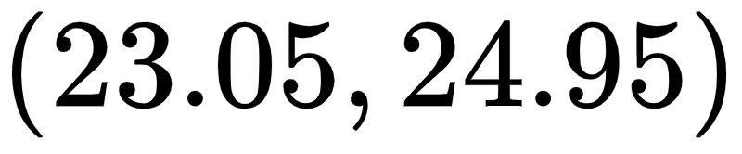
Two tailed test
Solution:
Solution using confidence interval method.
The confidence interval is given by
The CI = ( ) = ( )
Since µ₀ = 25, does not lie in (23.05, 24.95), we reject H₀. Thus there is enough evidence to conclude that the mean mileage is different from 25 kmph.
=

Slide 90
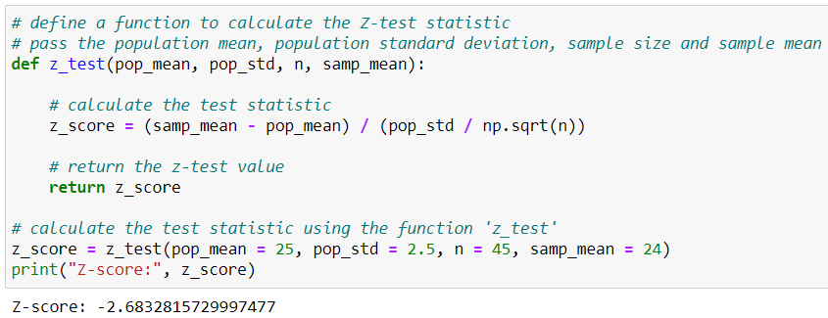
Two tailed test
Python solution: Calculate Z_{calc}
Reject H₀, as |Z_{calc}| > Z_{α/2}. Here |-2.68| > 2.575

Slide 91
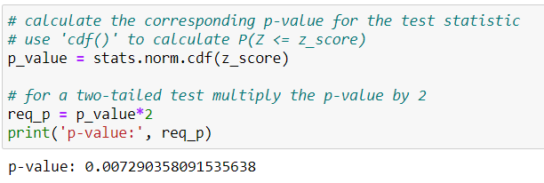
Two tailed test
Python solution: Calculate p-value
Since p-value < 0.01, we reject H₀.

Slide 92
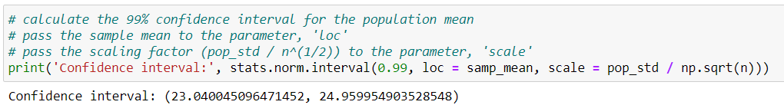
Two tailed test
Python solution: Calculate 99% confidence interval
Since µ₀ = 25, does not lie in the confidence interval, we reject H₀.

Slide 93
Left tailed test
Question:
A sample of 900 PVC pipes is found to have an average thickness of 12.5 mm. Can we assume that the sample is coming from a normal population with mean 13mm against that it is less than 13 mm. The population standard deviation is 1 mm. Test the hypothesis using the p-value method at 5% level of significance.

Slide 94
Left tailed test
Solution:
Here X: the thickness of PVC pipes X~N(µ,σ²)
Here, µ = 13mm , σ = 1 mm, = 12.5, n = 900
To test, H₀ : µ ≥ 13 against H₁ : µ < 13
Obtain the solution using p-value technique.

Slide 95
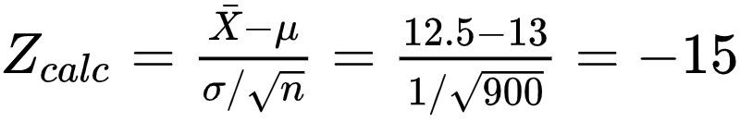
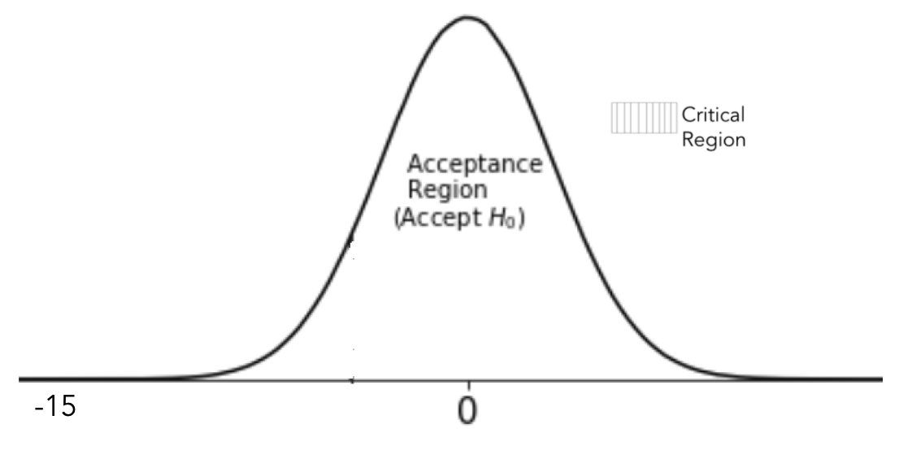
Left tailed test
Solution:
The test statistics:
The p-value = P(Z < Z_{calc}, under H₀) = P(Z < -15, µ = 13) = 0.00
Since p-value < 0.05, we reject H₀. Thus there is enough evidence to conclude that the sample may not be regarded as coming from population with mean 13

Slide 96
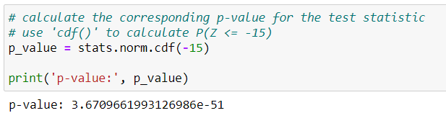
Left tailed test
Python solution: Calculate p-value
Since p-value < 0.05, we reject H₀.

Slide 97
Right tailed test
Question:
An e-commerce company claims that the mean delivery time of food items on their website in NYC is 60 minutes with a standard deviation of 30 minutes. A random sample of 45 customers ordered from the website, and the mean time for delivery was found to be 75 minutes. Is this enough evidence to claim that the mean time to get items delivered is more than 60 minutes. (assume normality of data)
Test the claim using p-value technique. [Use α = 0.05].

Slide 98
Right tailed test
Solution:
Here X: Time (in minutes) to receive the delivery X~N(µ,σ²)
Here, µ = 60 , σ = 30, = 75, n = 45
To test, H₀ : µ ≤ 60 against H₁ : µ > 60
Obtain the solution using p-value technique.

Slide 99
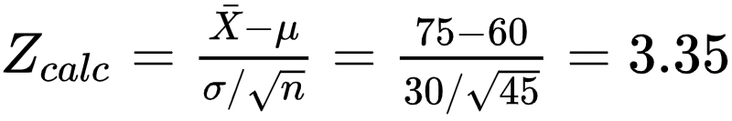
Right tailed test
Solution:
The test statistics:
The p-value = P(Z > Z_{calc}, under H₀) = P(Z > 3.35, µ = 60) = 0.0004
Since p-value < 0.05, we reject H₀. Thus there is enough evidence to conclude that the mean delivery time is more than 60 min
3.35

Slide 100
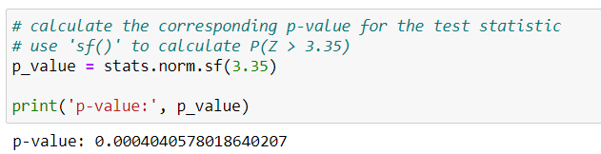
Right tailed test
Python solution: Calculate p-value
Since p-value < 0.05, we reject H₀.

Slide 101
Summary
The Z test can be used if the sample data is drawn from a normally distributed population
The normality of the dataset can be checked using Shapiro-Wilk test
Two tailed as well as one tailed (left/ right) Z test can be performed
The test statistic for the Z test follows normal distribution under the null hypothesis
The test statistic, p-value and confidence interval can be used to analyze the significance of the test

Slide 102
Errors in Hypothesis Testing

Slide 103
Probability of committing an error
P(Type I error) is the probability of wrongly rejecting a true null hypothesis
It is the level of significance (α) set for the hypothesis
An α of 0.05 suggests that one is willing to accept a 5% chance that you reject a true null hypothesis
In order to lower this risk, set a lower α. However, it will be more difficult to reject the false null hypothesis

Slide 104
Error in hypothesis testing
 |  | Test Decision
 |  | Reject H₀ | Accept H₀
Actual Situation | H₀ is True | Type I error Wrongly reject true H₀ | Correct Conclusion Correctly accept true H₀
 | H₀ is False | Correct Conclusion Correctly reject false H₀ | Type II error Wrongly accept false H₀

Slide 105
Probability of committing an error
P(Type II error) is the probability of wrongly accepting a false null hypothesis
Denoted by β
1 - β is the power of the test, i.e. correctly rejecting a false null hypothesis
In order to lower the risk of type II error, ensure the power of the test is high
In python, we calculate the power of a Z test using the ‘power.zt_ind_solve_power()’ from statsmodels library

Slide 106
Controlling the errors
Both errors cannot be controlled simultaneously
Fix one error and minimize the other
Generally α is fixed and β is controlled

Slide 107
Thank You

